Slide 1
Lecture 24: Introduction to FreeRTOS

Slide 2
Reference Books
Using the FreeRTOS Real-Time Kernel: A Practical Guide Cortex-M3 Edition
SAFERTOS™ User’s Manual

Slide 3
What is Real-Time?
“ Real time in operating systems:
The ability of the operating system to provide a required level of service in a bounded response time.”
- POSIX Standard 1003.1

Slide 4
Soft Real-Time
In a soft real-time system, it is considered undesirable, but not catastrophic, if deadlines are occasionally missed.
Also known as “best effort” systems
Most modern operating systems can serve as the base for a soft real time systems
Examples:
Multimedia transmission and reception
Networking, telecom (cellular) networks
Web sites and services
Computer games

Slide 5
Hard Real-Time
A hard real-time system has time-critical deadlines that must be met; otherwise a catastrophic system failure can occur.
Absolutely, positively, first time every time
Requires formal verification/guarantees of being to always meet its hard deadlines (except for fatal errors).
Examples:
Air traffic control
Vehicle subsystems control, e.g., airbags, brakes
Nuclear power plant control

Slide 6
Why Use a RTOS?
Task prioritization can help ensure an application meets its processing deadlines
Abstracting away timing information from applications
Good Maintainability/Extensibility
Good Modularity with tasks
Well-defined interfaces support team development
Easier testing with well-defined independent tasks
Code reuse
Improved efficiency with event-driven software
Idle task when no applications wishing to execute
Flexible interrupt handling
Easier control over peripherals

Slide 7

FreeRTOS
FreeRTOS is a real-time kernel (or real-time scheduler) targeting at hard real-time applications.
Simple
Portable
Royalty free
Concise
Primarily written in C
Few assembler functions
Thumb mode supported

Slide 8
The Cortex-M3 Port of FreeRTOS
The Cortex-M3 port includes all the standard FreeRTOS features:
Pre-emptive or co-operative scheduler operation
Very flexible task priority assignment
Queues
Binary semaphores
Counting semaphores
Recursive semaphores
Mutexes
Tick hook functions
Idle hook functions
Stack overflow checking
Trace hook macros

Slide 9
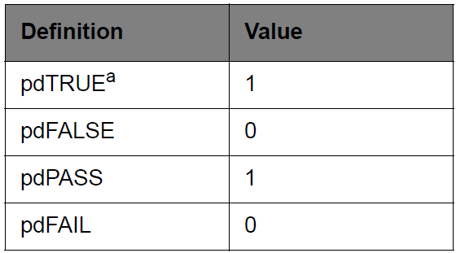
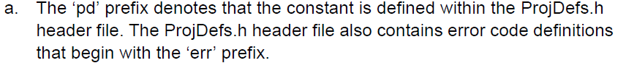
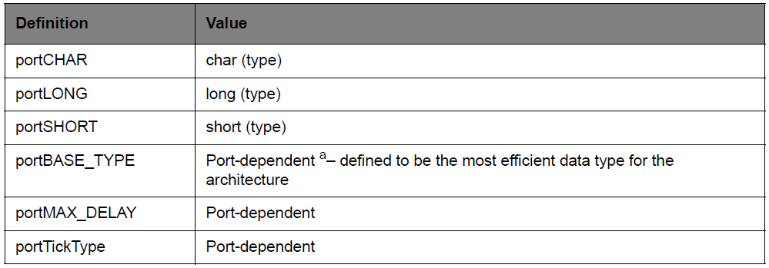
Coding Conventions
Some project definitions in ProjDefs.h
Port-dependent definitions

Slide 10
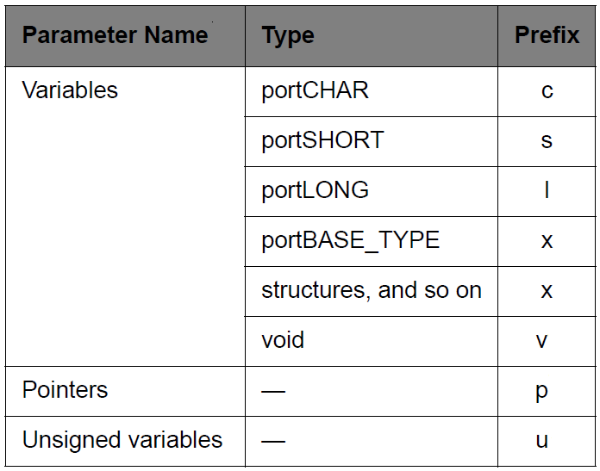
Coding Conventions
Naming conventions
For example, a pointer to a short will have the prefix ps;a pointer to void will have the prefix pv;an unsigned short will have the prefix us
Function names are also prefixed with their return type using the same convention

Slide 11
Resources Used By FreeRTOS
FreeRTOS makes use of
SysTick, PendSV, and SVC interrupts
These interrupts are not available for use by the application
FreeRTOS has a very small footprint
A typical kernel build will consume approximately 6KB of Flash space and a few hundred bytes of RAM
Each task also requires RAM to be allocated for use as the task stack

Slide 12
FreeRTOS, OpenRTOS, SafeRTOS
FreeRTOS uses a modified GPL license
FreeRTOS can be used in commercial applications
FreeRTOS itself remains open source
FreeRTOS users retain ownership of their intellectual property
OpenRTOS shares the same code base as FreeRTOS
provided under standard commercial license terms
Not open source
provides IP infringement protection
SafeRTOS has been developed compliance with various internationally recognized safety related standards.
SafeRTOS was originally derived from FreeRTOS
retains a similar usage model

Slide 13
Key Concepts in FreeRTOS
1. Task management
2. Queue management
3. Interrupt management
4. Resource management

Slide 14
1 Task Management
Topics covered:
How to implement tasks.
How to create one or more instances of a task.
How to use the task parameter.
How to change the priority of a task that has already been created.
How to delete a task.
How to implement periodic processing.
When the idle task will execute and how it can be used.

Slide 15
1.1 Tasks in FreeRTOS
With FreeRTOS, application can be structured as a set of autonomous tasks
Each task executes within its own context (e.g., stack) with no coincidental dependency on other tasks
The scheduler is responsible for starting, stop, swapping in, and swapping out tasks

Slide 16
1.2 Tasks Functions
Tasks are implemented as C functions
The prototype of a task function must return void and take a void pointer parameter
A task will typically execute indefinitely in an infinite loop: must never terminate by attempting to return to its caller
If required, a task can delete itself prior to reaching the function end
A single task function definition can be used to create any number of tasks
Each created task is a separate execution instance
Each created task has its own stack
Each created task has its own copy of any automatic variables defined within the task itself

Slide 17
1.2 Tasks Functions
The structure of a typical task function:
void ATaskFunction( void *pvParameters )
{
/* Each instance of this task function will have its own copy of the iVariableExample
variable. Except that if the variable was declared static – in which case only one copy of the
variable would exist and would be shared by all created instance.*/
int iVariableExample = 0;
/* A task will normally be implemented as in infinite loop. */
for( ;; )
{
/* The code to implement the task functionality will go here. */
}
/* Should the task implementation ever break out of the above loop then the task must be
deleted before reaching the end of this function. The NULL parameter passed to the
vTaskDelete() function indicates that the task to be deleted is the calling (this) task. */
vTaskDelete( NULL );
}

Slide 18
1.3 Task States
An application can consist of many tasks
Only one task of the application can be executed at any given time on the microcontroller (single core)
Thus, a task can exist in one of two states: Running or Not Running
Only the scheduler can decide which task should enter the Running state
A task is said to have been “switched in” or “swapped in” when transitioned from the Not Running to the Running state ( “switched out” or “swapped out” when transitioned from the Running state to the Not Running state)
The scheduler is responsible for managing the processor context:
Registers values
Stack contents

Slide 19
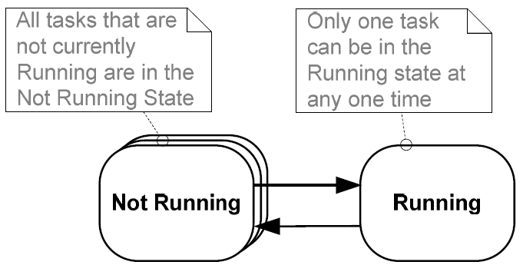
Task States and Transitions

Slide 20
1.4 Create a Task
A task can be created by calling xTaskCreate()
portBASE_TYPE xTaskCreate( pdTASK_CODE pvTaskCode,
const signed portCHAR * const pcName,
unsigned portSHORT usStackDepth,
void *pvParameters,
unsigned portBASE_TYPE uxPriority,
xTaskHandle *pxCreatedTask );
pvTaskCode
is a pointer to the function that implement the task
pcName
is a descriptive name for the task, not used by FreeRTOS
usStackDepth
specifies the number of words the stack of this task can hold

Slide 21
pvParameters
is the parameter that can be passed to the task function (pointer to a complex data structure)
uxPriority
is the priority of the task (0 is the lowest priority, configMAX_PRIORITIES-1 is the highest priority)
pxCreatedTask
is the handler of the generated task, which can be used to reference the task within API calls
Returned value
There are two possible return values:
1. pdTRUE: when the task was created successfully
2. errCOULD_NOT_ALLOCATE_REQUIRED_MEMORY: the task could not be created because there was insufficient heap memory available for FreeRTOS to allocate enough RAM to hold the task data structures and stack

Slide 22
A Simple Printing Application Example
void vTask1( void *pvParameters )
{
const char *pcTaskName = "Task 1 is running\r\n";
volatile unsigned long ul;
/* As per most tasks, this task is implemented in an infinite loop. */
for( ;; )
{ /* Print out the name of this task. */
vPrintString( pcTaskName );
/* Delay for a period. */
for( ul = 0; ul < mainDELAY_LOOP_COUNT; ul++ )
{
/* This loop is just a very crude delay implementation. There is nothing to do in here. Later examples will replace this crude loop with a proper delay/sleep function. */
}
}
}

Slide 23
void vTask2( void *pvParameters )
{
const char *pcTaskName = "Task 2 is running\r\n";
volatile unsigned long ul;
for( ;; )
{
vPrintString( pcTaskName );
for( ul = 0; ul < mainDELAY_LOOP_COUNT; ul++ ) {}
}
}

Slide 24
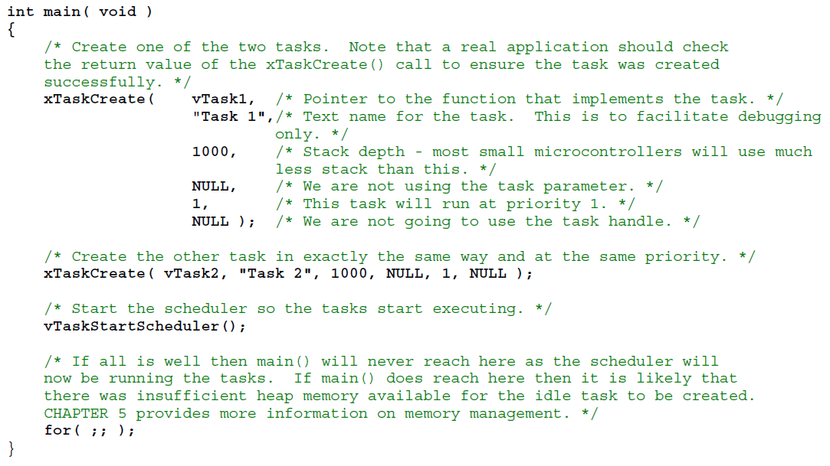

Slide 25
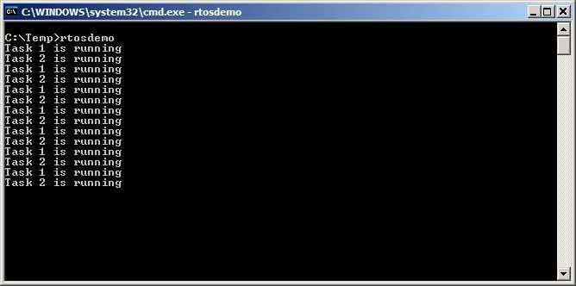
The Output Produced

Slide 26
1.5 Expanding the Not Running State
The Blocked state : A task that is waiting for an event
Tasks can enter the Blocked state to wait for two different types of event:
Temporal (time related) events where a delay period expiring or an absolute time being reached
For example, wait for 10 ms to pass
Synchronization events where the events originate from another task or interrupt
For example, wait for data to arrive on a queue
It is possible for a task to block on a synchronization event with a timeout
For example, wait for a maximum of 10 ms for data to arrive on a queue

Slide 27
Expanding the Not Running State
The Suspended state: tasks in the Suspended state are not available to the scheduler.
The only way into the Suspended state is through a call to the vTaskSuspend()API function
the only way out through a call to the vTaskResume()or xTaskResumeFromISR()API functions

Slide 28
Expanding the Not Running State
The Ready State: tasks that are in the Not Running but are not Blocked or Suspended
Tasks are able to run, and therefore ‘ready’ to run, but not currently in the Running state

Slide 29
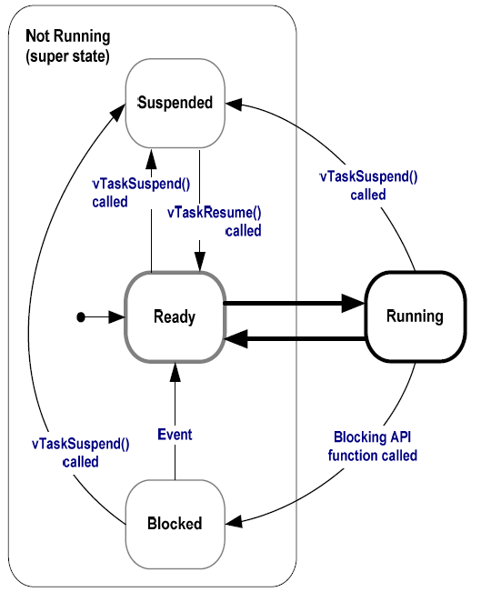
Task State Transitions

Slide 30
Example: Using the Blocked state to create a delay
The tasks in the previous examples generate delay using a null loop – polling a counter until it reaches a fixed value
Waste processor cycles
An efficient method is to create a delay with a call to the vTaskDelay() API function
vTaskDelay() places the calling task into the Blocked state for a fixed number of tick interrupts
The task in the Blocked state will not use any processing time at all
An alternative method is to use the vTaskDelayUntil() API function

Slide 31
vTaskDelay() Prototype
void vTaskDelay( portTickType xTicksToDelay );
xTicksToDelay
is the number of tick interrupts that the calling task should remain in the Blocked state before being transitioned back into the Ready state.
The constant portTICK_RATE_MS stores the time in milliseconds of a tick, which can be used to convert milliseconds into ticks.

Slide 32
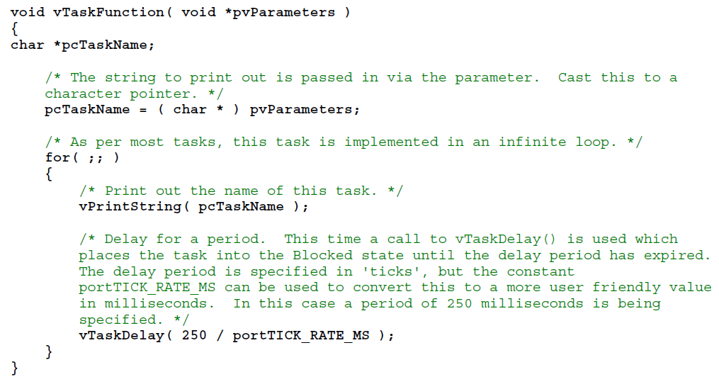
Improved Printing Application Example Using vTaskDelay()

Slide 33
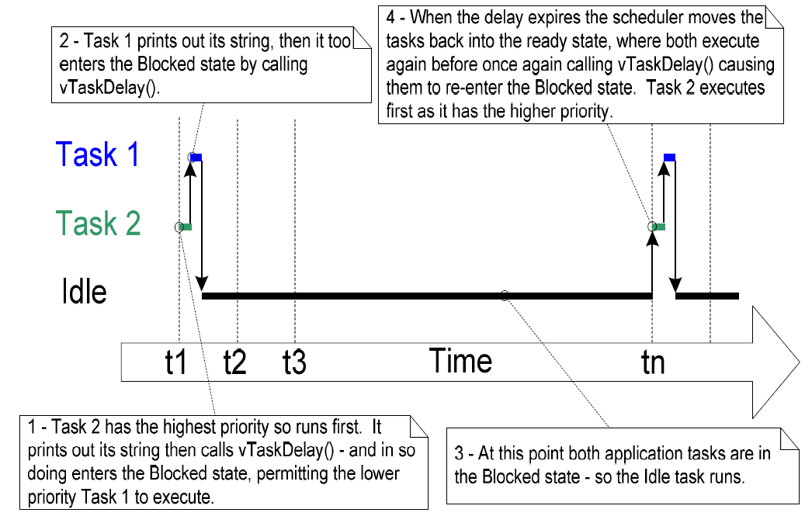
Execution Sequence When Using vTaskDelay()
The idle task is created automatically when the scheduler is started to ensure there is always at least one task that is able to run (at least one task in the Ready state)

Slide 34
vTaskDelayUntil() Prototype
void vTaskDelayUntil ( portTickType * pxPreviousWakeTime, portTickType xTicksToDelay );
pxPreviousWakeTime
holds the time at which the task last left the Blocked state (was ‘woken’ up). This time is used as a reference point to calculate the time at which the task should next leave the Blocked state.
The variable pointed to by pxPreviousWakeTime is updated automatically within the vTaskDelayUntil() function and should be initialized by the application code first.
xTicksToDelay
vTaskDelayUntil()is normally being used to implement a task that executes periodically; the frequency being set by this value which is specified in ‘ticks’

Slide 35
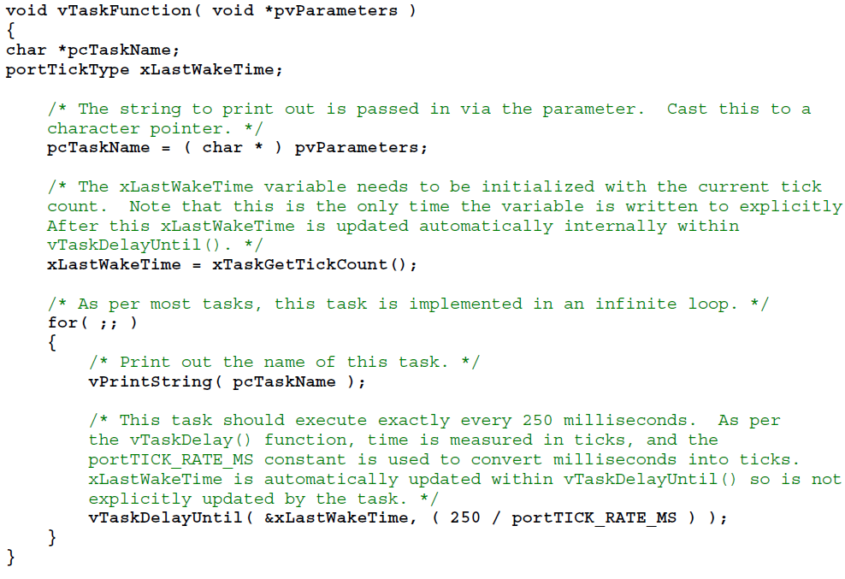
Improved Printing Application Example Using vTaskDelayUntil()

Slide 36
1.6 Task Priority
Higher priorities task run before lower priority task
Tasks with the same priority share CPU time (in time slices)
The scheduler runs itself at the end of each time slice to select the next task to run
The length of the time slice is set by the SysTick interrupt frequency
by configuring the configTICK_RATE_HZ while setting the compile configuration in FreeRTOSConfig.h

Slide 37
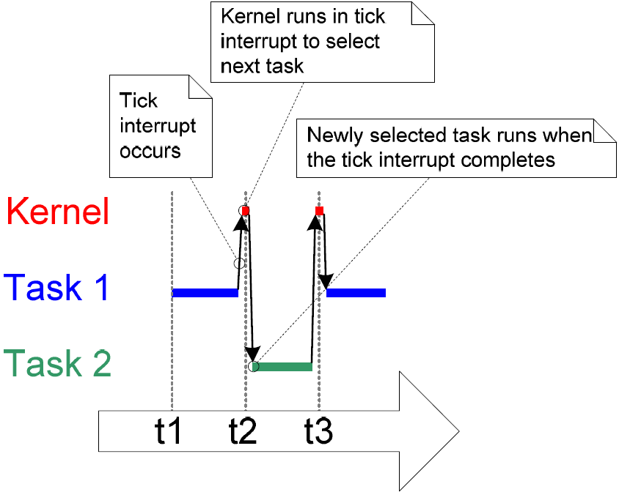
Execution Sequence of the Example

Slide 38
Change Task Priority
The initial priority of a task is assigned when created by using xTaskCreate()
The task priority can be queried by using the xTaskPriorityGet()
The task priority can be changed by using vTaskPrioritySet()
The range of priorities is configurable 0 - desired amount (configMAX_PRIORITIES in FreeRTOSConfig.h)
Low numeric values denote low priority tasks (0 is the lowest priority)

Slide 39
vTaskPrioritySet() & uxTaskPriorityGet()
void vTaskPrioritySet( xTaskHandle pxTask, unsigned portBASE_TYPE uxNewPriority );
pxTask
The handle of the task whose priority is being modified.
A task can change its own priority by passing NULL in place of a valid task handle
uxNewPriority
The priority to which the subject task is to be set
unsigned portBASE_TYPE uxTaskPriorityGet(xTaskHandle pxTask);
pxTask
The handle of the task whose priority is being queried.
Returned value
The priority currently assigned to the task being queried.

Slide 40
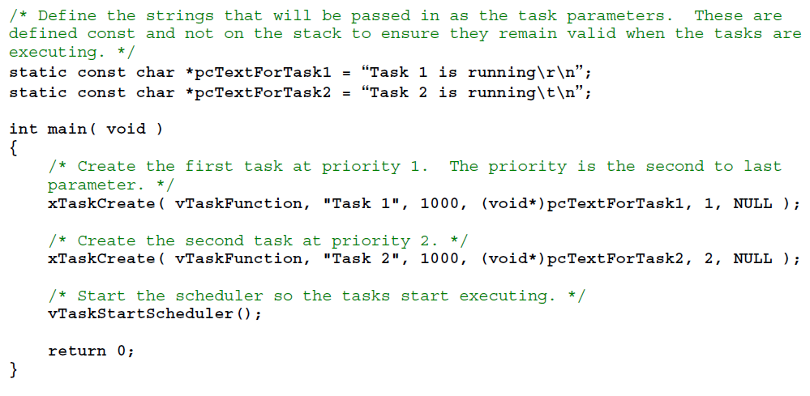
Experiment with Priorities

Slide 41
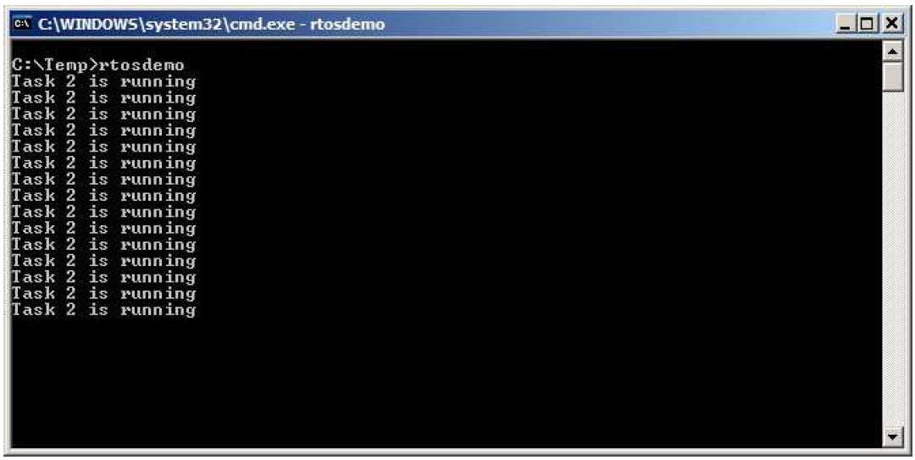
The Output Produced

Slide 42
1.7 Idle Task and Idle Task Hook Functions
The idle task is executed when no application tasks are in Running and Ready state
The idle task is automatically created by the scheduler when vTaskStartScheduler()is called
The idle task has the lowest possible priority (priority 0) to ensure it never prevents a higher priority application task
Application specific functionality can be directly added into the idle task via an idle hook (or call-back) function
An idle hook function is automatically called per iteration of the idle task loop
Can be utilized to execute low priority, background or continuous processing

Slide 43
1.9 Delete a Task
A task can use the vTaskDelete()API function to delete itself or any other task
The memory allocated by the kernel to a deleted task is freed by the idle task
vTaskDelete()prototype:
void vTaskDelete( xTaskHandle pxTaskToDelete );
pxTaskToDelete
The handle of the task that is to be deleted
A task can delete itself by passing NULL in place of a valid task handle

Slide 44
2 Queue Management
Topics covered:
How to create a queue.
How a queue manages the data it contains.
How to send data to a queue.
How to receive data from a queue.
What it means to block on a queue.
The effect task priorities have when writing to and reading from a queue.

Slide 45
2.1 Characteristics of a Queue
Queue is used for inter-communication among autonomous tasks
A queue can hold a finite number of fixed size data items
Normally, it is First In First Out (FIFO) buffers
Writing data to a queue causes a byte for byte copy of data
Reading data from a queue will remove the data
Any number of tasks can write (read) to (from) the same queue

Slide 46
Blocking on Queue Reads
If the queue is empty, a task attempting to read from the queue will be blocked
When new data is placed into the queue, the blocked task will automatically be moved from the Blocked state to the Ready state
When multiple tasks are blocked, the task with the highest priority will be unblocked
If the blocked tasks have equal priority, the task that has been waiting for data the longest will be unblocked
The blocked task will also be automatically moved to the Ready state if the specified block time expires before data becomes available.

Slide 47
Blocking on Queue Writes
If the queue is already full, a task attempting to write to the queue will be blocked
When there is space available in the queue, the blocked task will automatically be moved from the Blocked state to the Ready state
When multiple tasks are blocked, the task waiting for space with the highest priority will be unblocked
If the blocked tasks have equal priority, the task that has been waiting for space the longest will be unblocked
The blocked task will also be automatically moved to the Ready state if the specified block time expires

Slide 48
2.2 Using a Queue
A queue must be explicitly created before it can be used
xQueueCreate() is used to create a queue and returns an xQueueHandle to reference the queue it creates
xQueueHandle xQueueCreate( unsigned portBASE_TYPE uxQueueLength,
unsigned portBASE_TYPE uxItemSize );
uxQueueLength
The maximum number of items that the queue being created can hold at any one time
uxItemSize
The size in bytes of each data item that can be stored in the queue
Return value
If NULL is returned then the queue could not be created because there was insufficient heap memory available;
A non-NULL value being returned indicates that the queue was created successfully.

Slide 49
Write to a Queue
xQueueSendToFront()(xQueueSendToBack())is used to send data to the back/tail (front/head) of a queue
They should never be called from an interrupt service routine, instead, xQueueSendToFrontFromISR()(xQueueSendToBackFromISR()) should be used
portBASE_TYPE xQueueSendToBack( xQueueHandle xQueue,
const void * pvItemToQueue,
portTickType xTicksToWait );
xQueue The handle of the queue to which the data is being sent
pvItemToQueue A pointer to the data that will be copied into the queue
xTicksToWait
The maximum amount of time the task should remain in the Blocked state to wait for space to become available on the queue, if queue is full
Return value
pdPASS will only be returned if data was successfully sent to the queue;
errQUEUE_FULL will be returned if data could not be written to the queue because the queue was already full.

Slide 50
Read from a Queue
xQueueReceive() is used to receive (read) an item from a queue and the item is removed from the queue
xQueuePeek() is used to receive an item from a queue without the item being removed from the queue
In ISRs, xQueueReceiveFromISR() API function should be used
portBASE_TYPE xQueueReceive( xQueueHandle xQueue,
const void * pvBuffer,
portTickType xTicksToWait );
xQueue The handle of the queue to which the data is being received
pvBuffer A pointer to the memory into which the received data will be copied
xTicksToWait
The maximum amount of time the task should remain in the Blocked state to wait for data to become available on the queue, if queue is empty
Return value
pdPASS will only be returned if data was successfully read from the queue;
errQUEUE_EMPTY is returned when data could not be read from the queue because the queue was already empty.

Slide 51
Query a Queue
uxQueueMessagesWaiting() is used to query the number of items that are currently in a queue
In ISRs, uxQueueMessagesWaitingFromISR() API function should be used
unsigned portBASE_TYPE uxQueueMessagesWaiting( xQueueHandle xQueue );
xQueue
The handle of the queue being queried
Return value
The number of items that the queue being queried is currently holding.

Slide 52
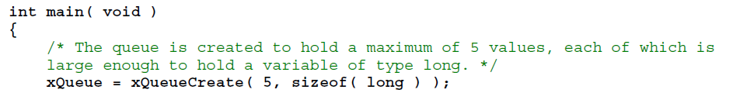
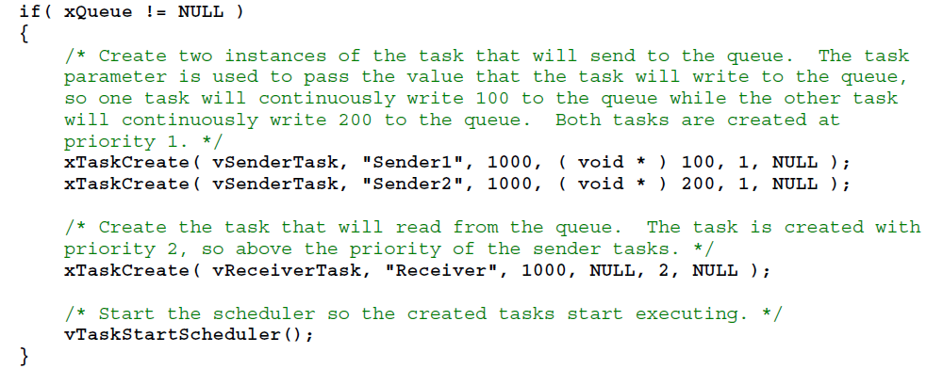
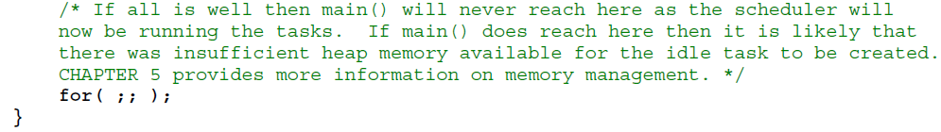
Example of Using Queue

Slide 53


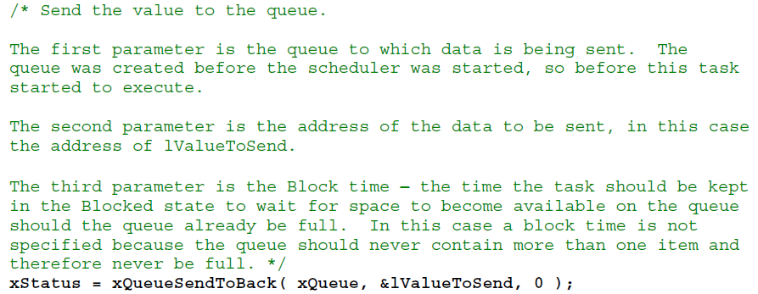
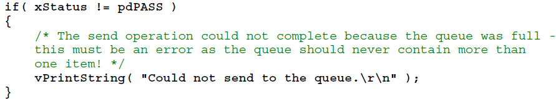
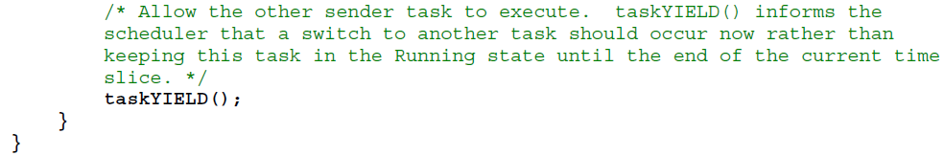

Slide 54
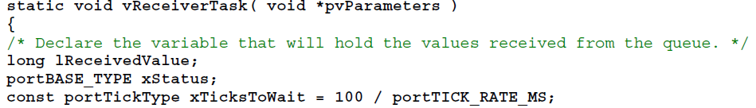
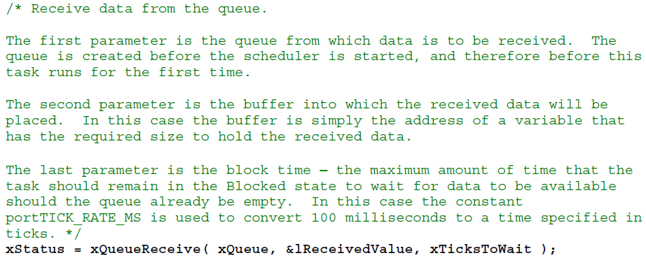
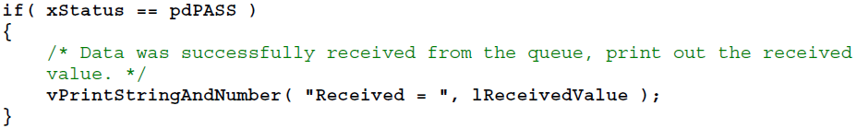


Slide 55
2.3 Working with Large Data
If the size of data being stored in the queue is large, it is preferable to use pointers to the data rather than copy the data itself
More efficient in both processing time and the amount of RAM required
It is essential to ensure that both tasks do not modify the memory contents simultaneously
Dynamically allocated memory should be freed by exactly one task and no tasks should attempt to access the memory after it has been freed

Slide 56
3 Interrupt Management
Topics covered:
Which FreeRTOS API functions can be used from within an interrupt service routine.
How a deferred interrupt scheme can be implemented.
How to create and use binary semaphores and counting semaphores.
The differences between binary and counting semaphores.
How to use a queue to pass data into and out of an interrupt service routine.

Slide 57
3.1 Deferred Interrupt Processing
Binary Semaphores used for Synchronization
A Binary Semaphore can be used to unblock a task each time a particular interrupt occurs
The majority of the interrupt event processing can be implemented within the synchronized task in the ISR
Only a very fast and short portion remaining directly
The interrupt processing is said to have been ‘deferred’ to a ‘handler’ task
The handler task uses a blocking ‘take’ call to a semaphore and enters the Blocked state to wait for the event to occur
When the event occurs, the ISR uses a ‘give’ operation on the same semaphore to unblock the task

Slide 58
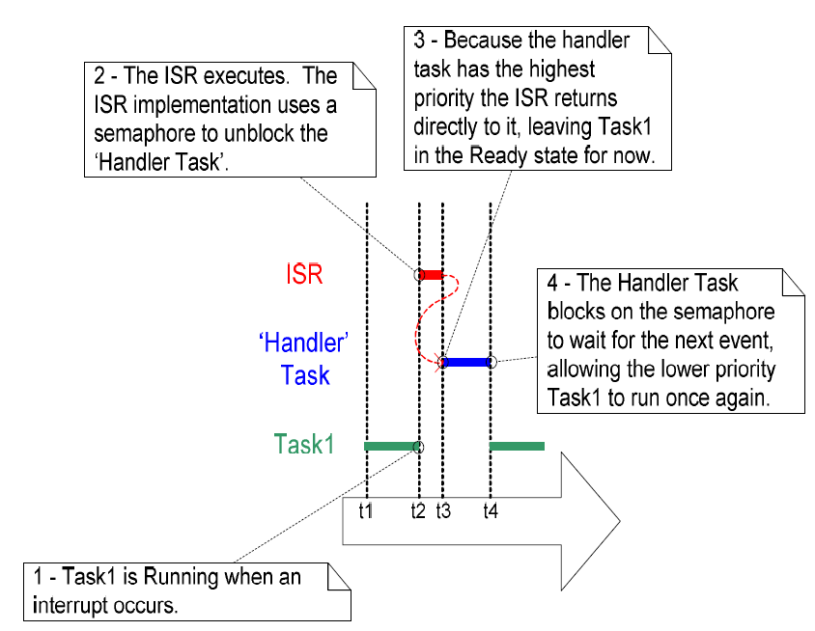
Interrupt and Handler Task

Slide 59
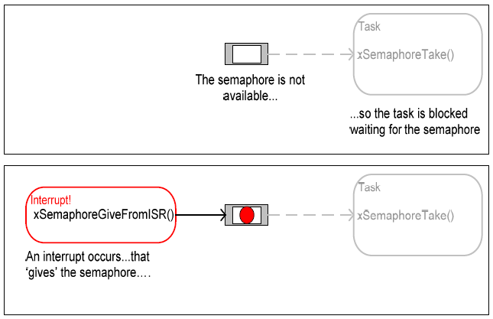
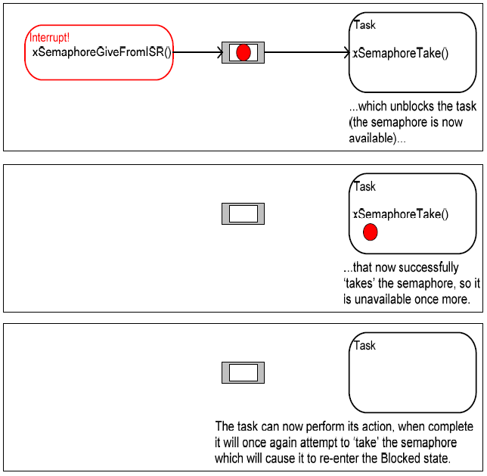
Interrupt and Handler Task

Slide 60
Create a Binary Semaphore
Use the vSemaphoreCreateBinary() API function (macro) to create a binary semaphore
void vSemaphoreCreateBinary(xSemaphoreHandle xSemaphore);
xSemaphore
The semaphore being created

Slide 61
‘Take’ a Semaphore
Use xSemaphoreTake()to ‘take’ a semaphore
portBASE_TYPE xSemaphoreTake(xSemaphoreHandle xSemaphore, portTickType xTicksToWait );
xSemaphore
The semaphore being ‘taken’
xTicksToWait
The maximum amount of time the task should remain in the Blocked state;
Setting xTicksToWait to portMAX_DELAY will cause the task to wait indefinitely
Return value
pdPASS will only be returned if it was successful in obtaining the semaphore
pdFALSE if the semaphore was not available

Slide 62
‘Give’ a Semaphore
Use xSemaphoreGive()(xSemaphoreGiveFromISR())to ‘give’ a semaphore (when in an ISR)
portBASE_TYPE xSemaphoreGiveFromISR(
xSemaphoreHandle xSemaphore,
portBASE_TYPE *pxHigherPriorityTaskWoken );
xSemaphore
The semaphore being ‘given’
pxHigherPriorityTaskWoken
If the handle task has a higher priority than the currently executing task (the task that was interrupted), this value will be set to pdTRUE
Return value
pdPASS will only be returned if successful
pdFAIL if a semaphore is already available and cannot be given

Slide 63
3.2 Counting Semaphores
When interrupts come at a speed faster than the handler task can process, events will be lost
Counting semaphore can be thought of as queues that have a length of more than one
Each time a counting semaphore is ‘given’, another space in its queue is used, count value is the length of the queue
Counting semaphores are typically used for two things:
Counting events: the count value is the difference between the number of events that have occurred and the number that have been processed
Resource management: the count value indicates the number of resources available; a task must first obtains a semaphore before obtains the control of a resource; a task returns a semaphore when finishing with the resource

Slide 64
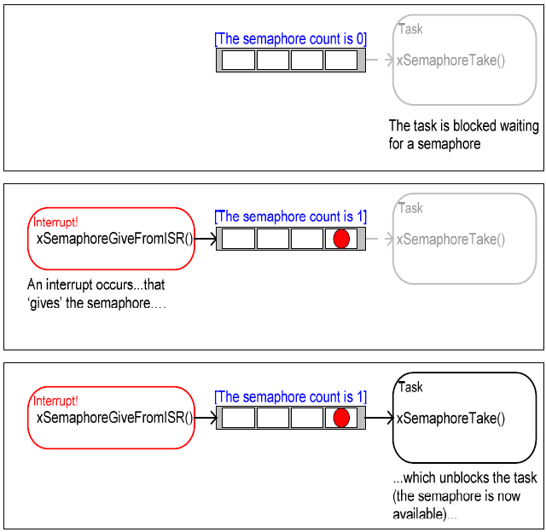
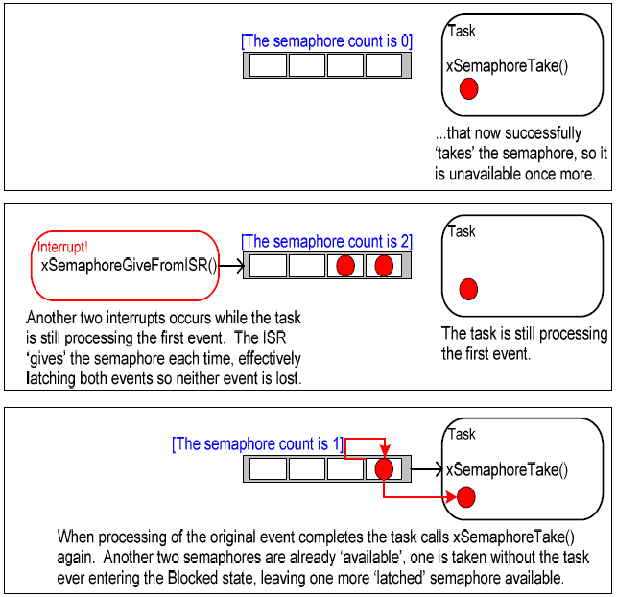
Using a counting semaphore to ‘count’ events

Slide 65
Create a Counting Semaphore
Use xSemaphoreCreateCounting()to create a counting semaphore
xSemaphoreHandle xSemaphoreCreateCounting(
unsigned portBASE_TYPE uxMaxCount,
unsigned portBASE_TYPE uxInitialCount );
uxMaxCount
The maximum value the semaphore will count to
uxInitialCount
The initial count value of the semaphore after it has been created
Return value
If NULL is returned then the semaphore could not be created because there was insufficient heap memory available
A non-NULL value being returned indicates that the semaphore was created successfully. The returned value should be stored as the handle to the created semaphore.

Slide 66
4 Resource Management
Resources that are shared between tasks or between tasks and interrupts needs to be managed using a ‘mutual exclusion’ technique to ensure data consistency
Topics covered:
When and why resource management and control is necessary.
What a critical section is.
What mutual exclusion means.
What it means to suspend the scheduler.
How to use a mutex.
How to create and use a gatekeeper task.
What priority inversion is and how priority inheritance can lessen (but not remove) its impact.

Slide 67
4 Resource Management
Resources that are shared between tasks or between tasks and interrupts needs to be managed using a ‘mutual exclusion’ technique to ensure data consistency
Topics covered:
When and why resource management and control is necessary.
What a critical section is.
What mutual exclusion means.
What it means to suspend the scheduler.
How to use a mutex.
How to create and use a gatekeeper task.
What priority inversion is and how priority inheritance can lessen (but not remove) its impact.

Slide 68
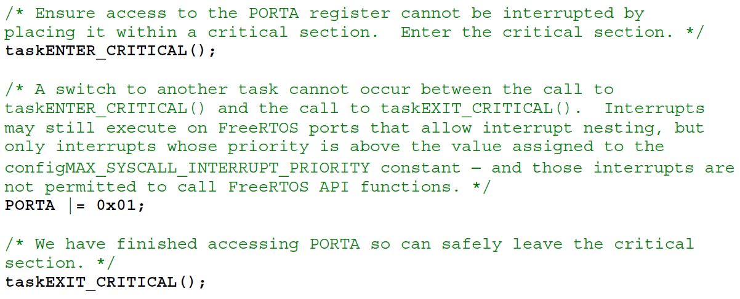
4.1 Basic Critical Sections
Basic critical sections protect a region of code from access by other tasks and by interrupts
Regions of code that are surrounded by calls to the macros taskENTER_CRITICAL() and taskEXIT_CRITICAL() respectively, e.g.,
A very crude method of providing mutual exclusion as all or partial interrupts are disabled

Slide 69
4.2 Suspending (Locking) the Scheduler
Critical sections can also be created by suspending the scheduler
A critical section that is too long to be implemented by simply disabling interrupts can instead be implemented by suspending the scheduler
The scheduler is suspended by calling vTaskSuspendAll()
void vTaskSuspendAll( void );
The scheduler is resumed by calling xTaskResumeAll()
portBASE_TYPE xTaskResumeAll( void );
Return value
pdTRUE if a previously pending context switch being performed before xTaskResumeAll() returns
pdFALSE otherwise

Slide 70
4.3 Mutexes
A Mutex is a special type of binary semaphore that is used to control access to a resource that is shared between two or more tasks
The mutex can be conceptually thought of as a token associated with the resource being shared
For a task to legitimately access the resource it must first successfully ‘take’ the token
When the token holder has finished with the resource it must ‘give’ the token back.

Slide 71
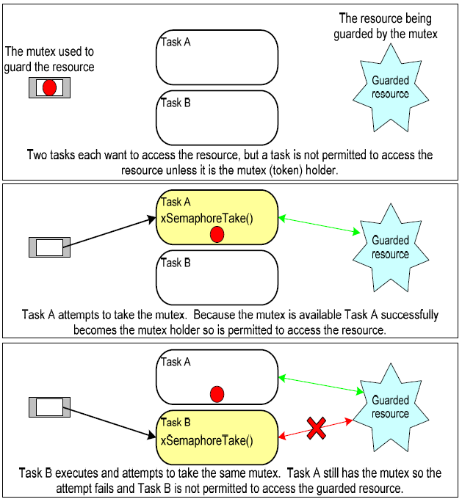
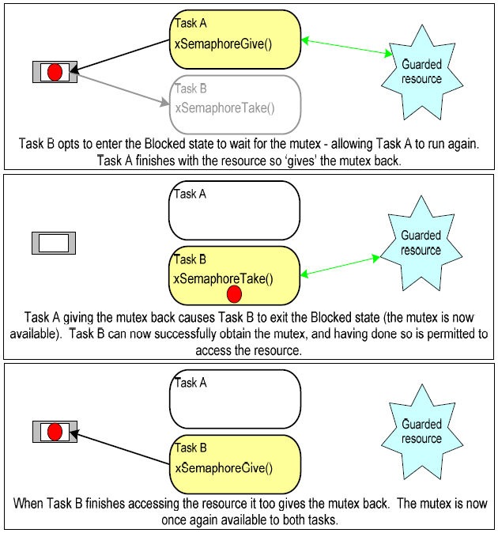
Mutual Exclusion Implemented Using a Mutex

Slide 72
Create a Mutex
Use xSemaphoreCreateMutex() to create a mutex
xSemaphoreHandle xSemaphoreCreateMutex( void );
Return value
If NULL is returned then the mutex could not be created because there was insufficient heap memory available
A non-NULL value being returned indicates that the mutex was created successfully. The returned value should be stored as the handle to the created mutex.

Slide 73
4.4 Priority Inversion & Priority Inheritance
With a mutex, it is possible that a task with a higher priority has to wait for a task with a lower priority which hold the mutex to give up the control of the mutex
A higher priority task being delayed by a lower priority task in this manner is called ‘priority inversion’.
Priority inheritance works by temporarily raising the priority of the mutex holder to that of the highest priority task that is attempting to obtain the same mutex
The priority of the mutex holder is automatically reset back to its original value when it gives the mutex back
Priority inheritance does not ‘fix’ priority inversion, it merely lessens its impact.

Slide 74
4.5 Deadlock
Deadlock occurs when two tasks are both waiting for a resource that is held by the other, e.g.,
Task A executes and successfully takes mutex X.
Task A is pre-empted by Task B.
Task B successfully takes mutex Y before attempting to also take mutex X – but mutex X is held by Task A so is not available to Task B. Task B opts to enter the Blocked state to wait for mutex X to be released.
Task A continues executing. It attempts to take mutex Y – but mutex Y is held by Task B so is not available to Task A. Task A opts to enter the Blocked state to wait for mutex Y to be released.

Slide 75
4.6 Gatekeeper Tasks
Gatekeeper tasks provide a clean method of implementing mutual exclusion without the worry of priority inversion or deadlock
A gatekeeper task is a task that has sole ownership of a resource
A task needing to access the resource can only do so indirectly by using the services of the gatekeeper

